Slide 1

Neural Substrates of Attention and Awareness
Dan Birman
Gardner Lab
Frisem – 2015-04-17

Slide 4
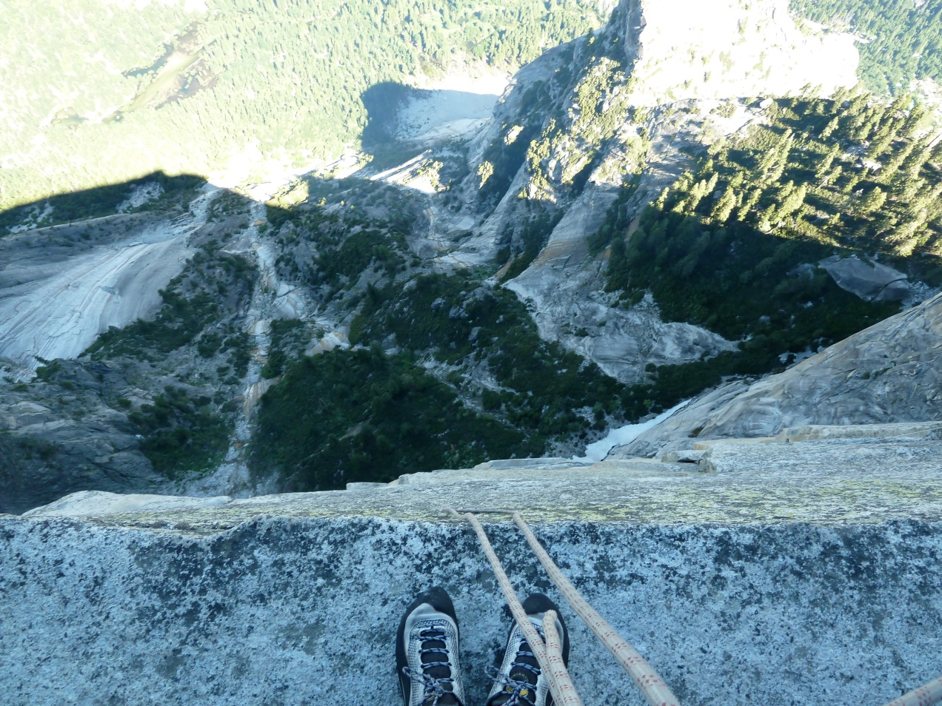

Slide 5
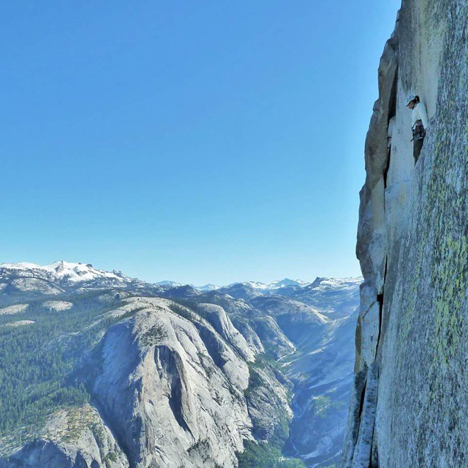

Slide 7







Slide 8
Neural Substrates of Attention and Awareness
Dan Birman
Gardner Lab
Frisem – 2015-04-17

Slide 11


Slide 12


Slide 13
Attention as a Pre-Requisite to Awareness
Dual task designs “pull” attention to one task, causing inattentional blindness for other stimuli.
“we believe […] there is no conscious perception without attention” (Mack & Rock, 1998)

Slide 14
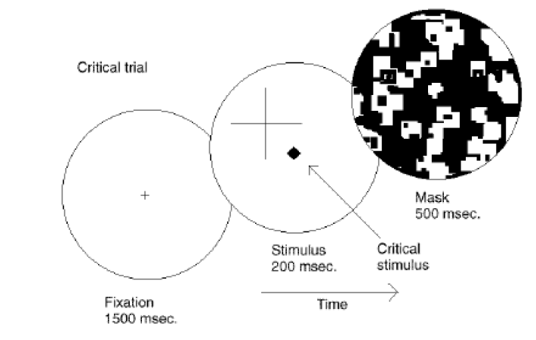
Attention as a Pre-Requisite to Awareness
Dual task designs “pull” attention to one task, causing inattentional blindness for other stimuli.
“we believe […] there is no conscious perception without attention” (Mack & Rock, 1998)
Mack & Rock, 1998
Notes:
There is one situation where attention (seems) to not be a pre-requisite for awareness

Slide 15
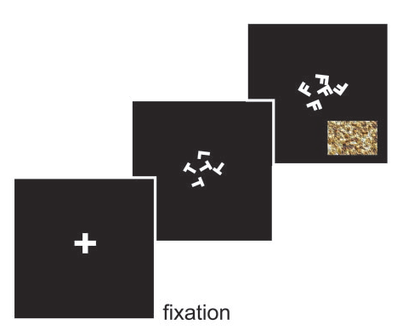
Gist Perception
“The close relationship between attention and
consciousness has led many scholars to conflate these processes“ (Koch & Tsuchiya, 2006)
Li et al., 2002

Slide 16
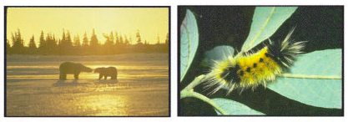
Gist Perception
“The close relationship between attention and
consciousness has led many scholars to conflate these processes“ (Koch & Tsuchiya, 2006)
Li et al., 2002

Slide 17
Gist Perception vs. Inattentional Blindness

Slide 18
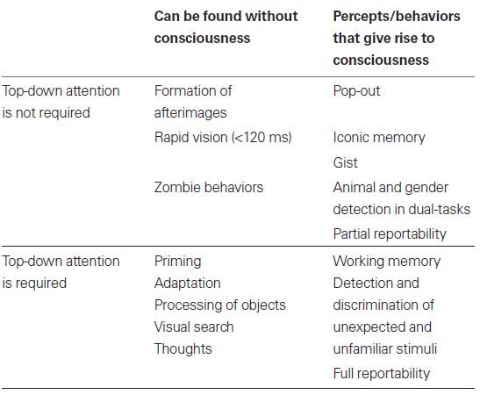
P
Perception of Stimulus:
Unaware
Aware
Unattended
Stimulus Is:
A
Attended

Slide 19
P
Perception of Stimulus:
Unaware
Aware
Unattended
Stimulus Is:
A
Attended
Normal Vision

Slide 20
P
Perception of Stimulus:
Unaware
Aware
Unattended
Gist Perception
Stimulus Is:
A
Attended
Normal Vision

Slide 21
P
Perception of Stimulus:
Unaware
Aware
Unattended
Inattentional
Blindness
Gist Perception
Stimulus Is:
A
Attended
Normal Vision

Slide 22
P
Jumble of Phenomena
Perception of Stimulus:
Unaware
Aware
Unattended
Inattentional
Blindness
Gist Perception
Stimulus Is:
A
Attended
Continuous Flash
Suppression
Normal Vision

Slide 23
P
Perception of Stimulus:
Unaware
Aware
Unattended
Inattentional
Blindness
Gist Perception
Stimulus Is:
A
Attended
Continuous Flash
Suppression
Normal Vision

Slide 24
P
Perception of Stimulus:
Unaware
Aware
Catch:
Unattended
Inattentional
Blindness
Gist Perception
Stimulus Is:
A
Cued:
Attended
Continuous Flash
Suppression
Normal Vision

Slide 25
P
Perception of Stimulus:
Perceptually Identical:
Unaware
Perceptually Distinct:
Aware
Catch:
Unattended
Stimulus Is:
A
Cued:
Attended

Slide 26
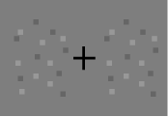
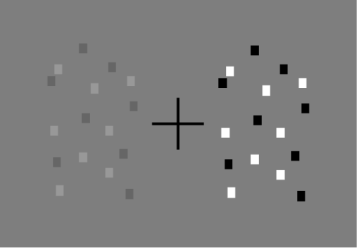
P
Perception of Stimulus:
Perceptually Identical:
Unaware
Perceptually Distinct:
Aware
Catch:
Unattended
Stimulus Is:
A
Cued:
Attended

Slide 27
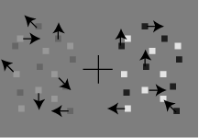
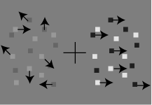
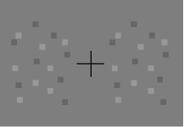
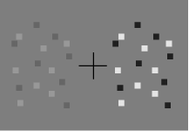
P
Perception of Stimulus:
Perceptually Identical:
Unaware
Perceptually Distinct:
Aware
Catch: Coherence
Unattended
Stimulus Is:
A
Cued: Contrast
Attended

Slide 28
P
Perception of Stimulus:
Perceptually Identical:
Unaware
Perceptually Distinct:
Aware
Catch: Coherence
Unattended
Stimulus Is:
A
Cued: Contrast
Attended

Slide 29
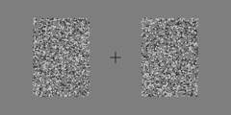
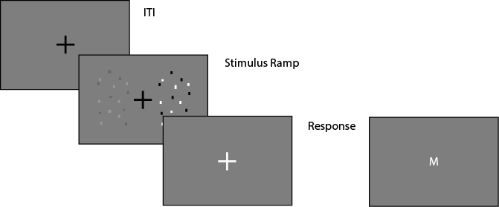
Task Design

Slide 30
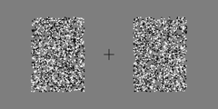
Task Design

Slide 31
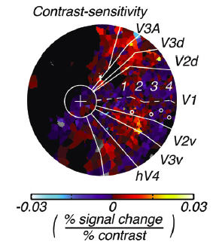
Contrast
Notes:
First attempt: dual

Slide 32
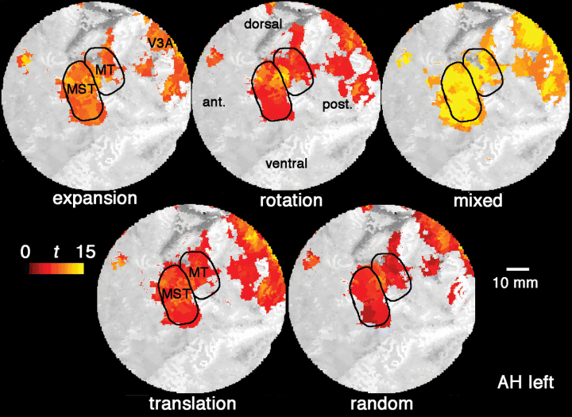
Contrast and Coherence
Notes:
First attempt: dual

Slide 33
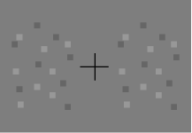
Neural Substrate of Awareness
100%
Performance (%)
50%
.44 .88 1.75 3.5 7 14 28
Difference in Stimulus Strength

Slide 34
Neural Substrate of Awareness
100%
This plot starts with actual data, then add the weibull fit
Do this for contrast at like 20% or something
Performance (%)
50%
.44 .88 1.75 3.5 7 14 28
Difference in Stimulus Strength

Slide 35
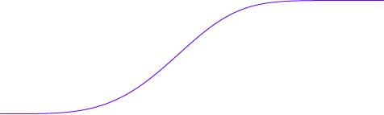
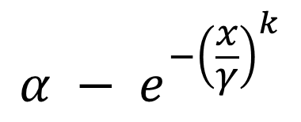
Neural Substrate of Awareness
$$α − e^{−{\left(\frac{x}{γ}\right)}^{k}}$$
100%
~80% Performance
Performance (%)
50%
.44 .88 1.75 3.5 7 14 28
Difference in Stimulus Strength

Slide 36
Neural Substrate of Awareness
$$α − e^{−{\left(\frac{x}{γ}\right)}^{k}}$$
100%
~80% Performance
Performance (%)
3.5% Contrast
Threshold
50%
.44 .88 1.75 3.5 7 14 28
Difference in Stimulus Strength

Slide 37
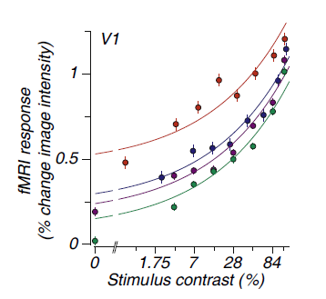
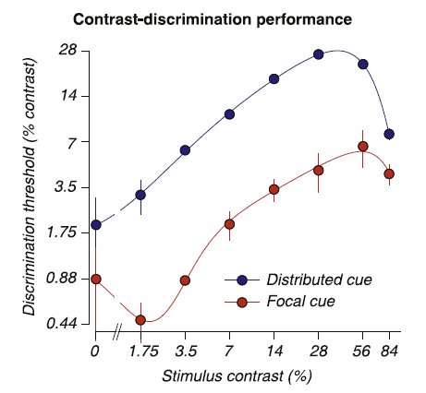
Neural Substrate of Awareness
Attended
100%
~80% Performance
Unattended
Performance (%)
3.5% Contrast
Threshold
50%
.44 .88 1.75 3.5 7 14 28
Threshold Size

Slide 38
Neural Substrate of Awareness
Unaware:
No Discrimination
Aware:
Can Discriminate
Attended
100%
Unattended
Performance (%)
50%
.44 .88 1.75 3.5 7 14 28
Threshold Size

Slide 39
P
You were going to make this slide show the weibull function so that it’s obvious how you’re
generating stimuli
Perceptually Identical:
Unaware
Perceptually Distinct:
Aware
Catch: Coherence
Unattended
A
Cued: Contrast
Attended

Slide 40
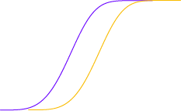
Neural Substrate of Awareness
Unaware:
No Discrimination
Aware:
Can Discriminate
Attended
100%
Unattended
Performance (%)
50%
.44 .88 1.75 3.5 7 14 28
Threshold Size

Slide 41
Neural Substrate of Awareness
Unaware:
No Discrimination
Aware:
Can Discriminate
Attended
100%
Unattended
Performance (%)
50%
.44 .88 1.75 3.5 7 14 28
Threshold Size

Slide 42
Neural Substrate of Awareness
Attended
100%
Unattended
Performance (%)
50%
.44 .88 1.75 3.5 7 14 28
Threshold Size

Slide 43
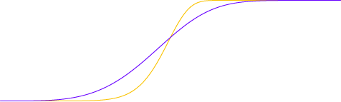
Neural Substrate of Awareness
Attended
100%
Unattended
Performance (%)
50%
.44 .88 1.75 3.5 7 14 28
Threshold Size

Slide 44
Neural Substrate of Awareness

Slide 45
Neural Substrate of Awareness

Slide 46
Neural Substrate of Awareness

Slide 47
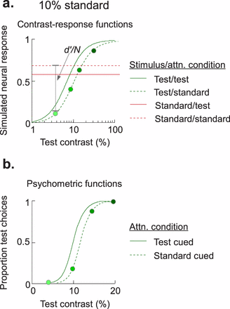
Pestilli et al. 2011
Cutrone et al. 2014

Slide 48
Neural Substrate of Awareness

Slide 49
Neural Substrate of Awareness
Outside
Inside Scanner

Slide 50
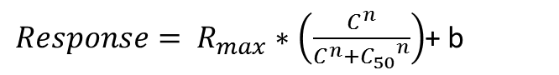
Neural Substrate of Attention
BOLD Magnitude
Attended
$Response= R_{max}∗\left(\frac{C^{n}}{C^{n}+{C_{50}}^{n}}\right)$+ b
Pestilli et al., 2011

Slide 51
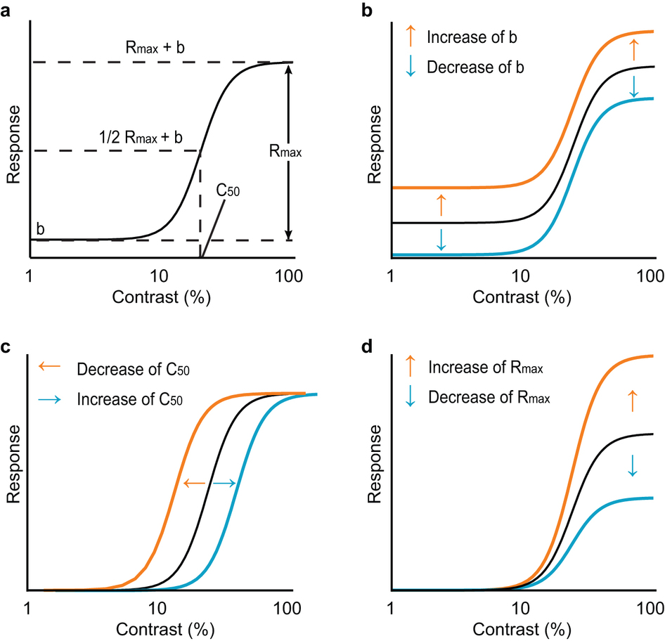
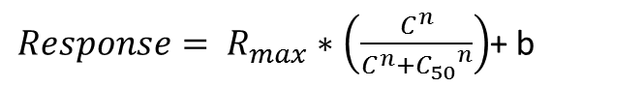
$Response= R_{max}∗\left(\frac{C^{n}}{C^{n}+{C_{50}}^{n}}\right)$+ b
Baseline Shift
Response Gain
Contrast Gain
Soma et al. 2013

Slide 52
Neural Substrate of Attention
BOLD Magnitude
Attended
Unattended
Pestilli et al., 2011

Slide 53
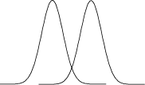

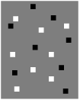
Neural Substrate of Attention
Bold Response Magnitude
Attended
Unattended

Slide 54
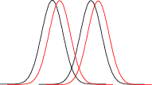
Neural Substrate of Attention
Attended
Unattended
Pestilli et al., 2011

Slide 55
Neural Substrate of Attention
Attended
Unattended
Pestilli et al., 2011

Slide 56
Neural Substrate of Attention
Attended
Unattended

Slide 57
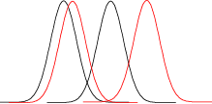
Neural Substrate of Attention
Attended
Unattended

Slide 58
Neural Substrate of Attention
Attended
Unattended

Slide 59
Neural Substrate of Attention
Behavioral Performance ←→ BOLD Magnitude
Attended
Unattended
Pestilli et al., 2011

Slide 60
Neural Substrate of Attention
Attended
Unattended
7%
14%

Slide 61
Neural Substrate of Attention
Psychophysical Threshold: ~80% Performance
Attended
Unattended
7%
14%

Slide 62
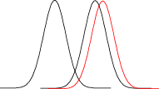
Neural Substrate of Attention
Attended
Unattended
7%
14%

Slide 63
Neural Substrate of Attention
Attended
Unattended
7%
14%
Pestilli et al., 2011

Slide 64
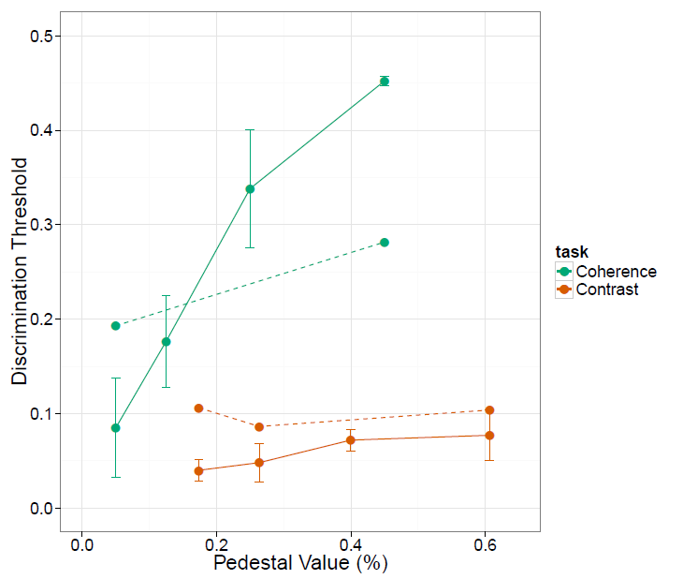

Slide 65
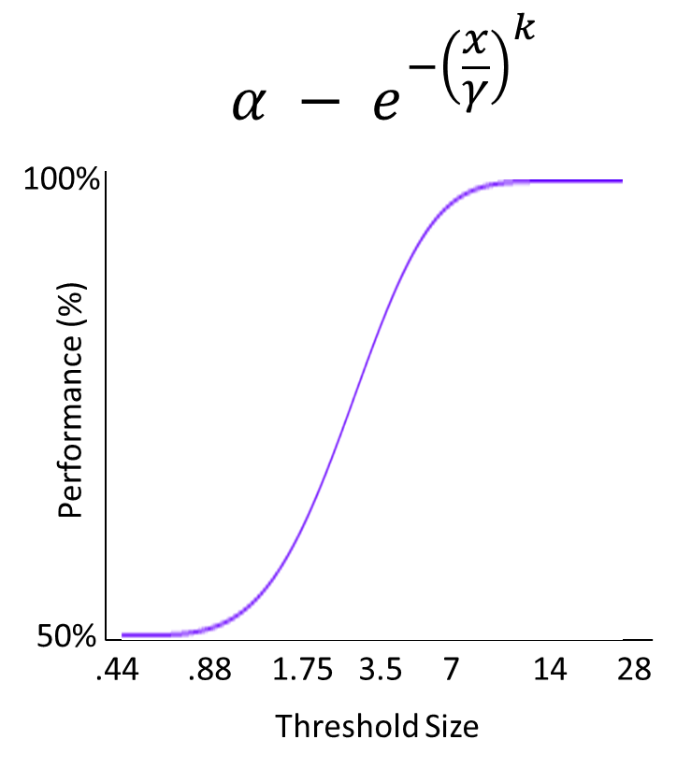
If attention and awareness are dissociable, we expect to see dissociated neural correlates.
BOLD Response
Modulated by Attention
Discrimination
Performance
Notes:
First attempt: dual

Slide 66
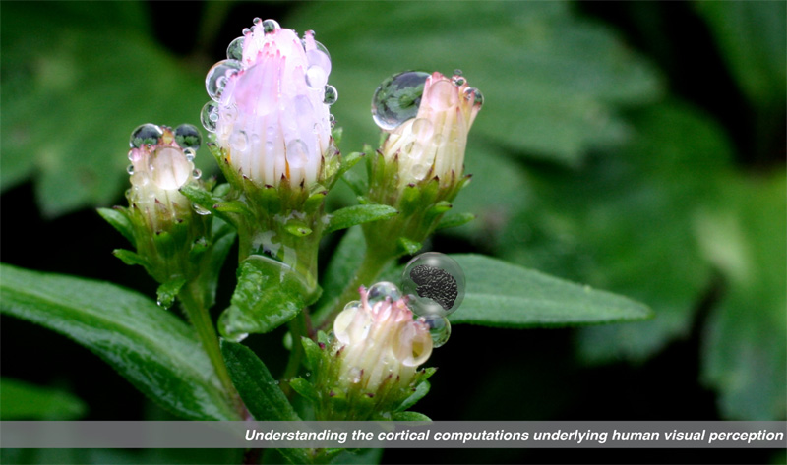

Gardner Lab @ Stanford University
Thank You!
Justin Gardner
Steeve Laquitaine
1st Year Cohort

